Slide 1
Where to find materials
for your
Solar Car Project
Joel Pitts
Greenville High School

Slide 2
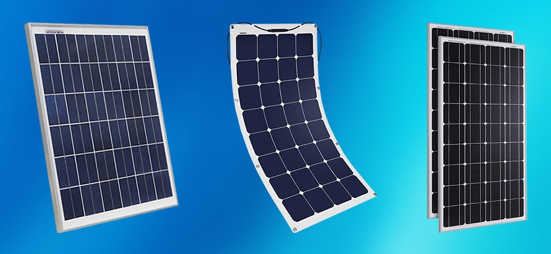
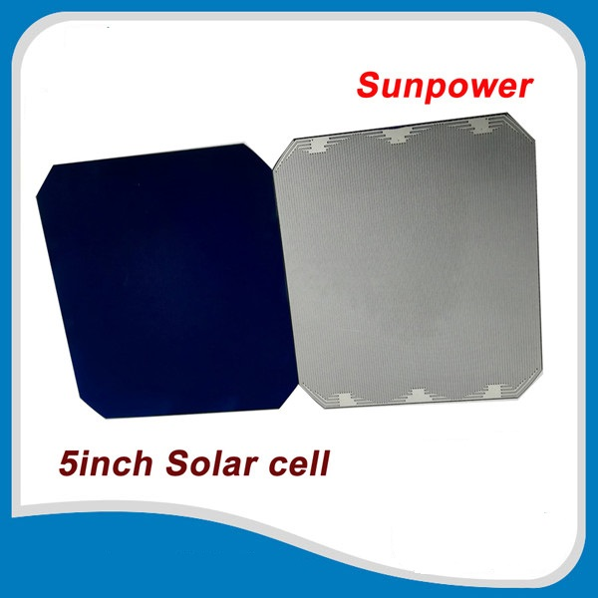
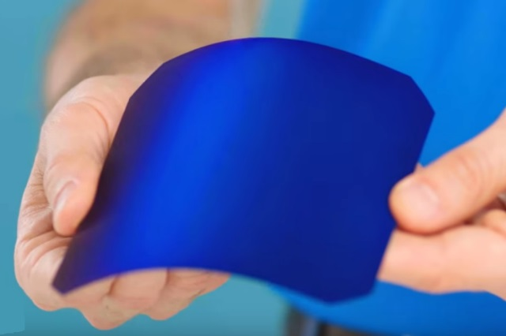
Solar Panels & Cells
Unboundsolar- https://unboundsolar.com/
SBM Solar - www.sbmsolar.com
CED Green Tech- https://www.cedgreentech.com/
Maxeon (Sunpower) – Gen II (22.5% efficient), or Gen III (24.4% efficient) cells
https://www.makeyoursolar.com/
Amazon & Ebay

Slide 3
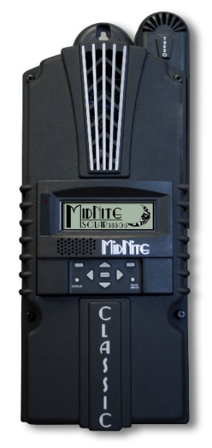
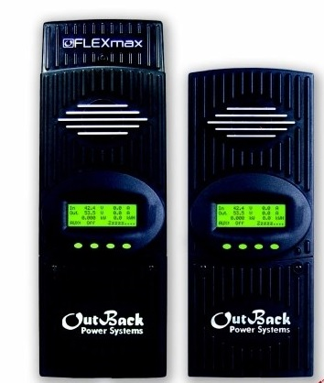
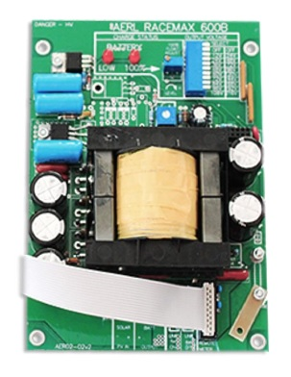
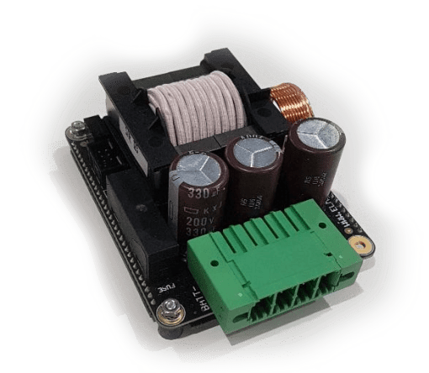
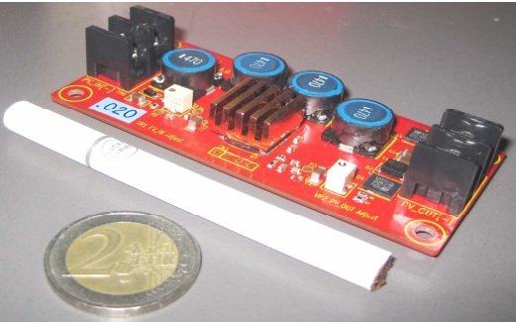
Multi Point Power Tracker
(aka: MPPT, Power Tracker, Charge Controller)
POWER TRACKERS
Unboundsolar- https://unboundsolar.com/
MidNite Solar - www.midnitesolar.com
AERL - https://www.aerl.com.au/
Genasun – https://genasun.com
Outback Power - http://www.outbackpower.com
Nomura Co - https://www.facebook.com/NomuraCo
Elmar - https://www.prohelion.com/shop/mppt/elmar-solar-race-mppt/

Slide 4
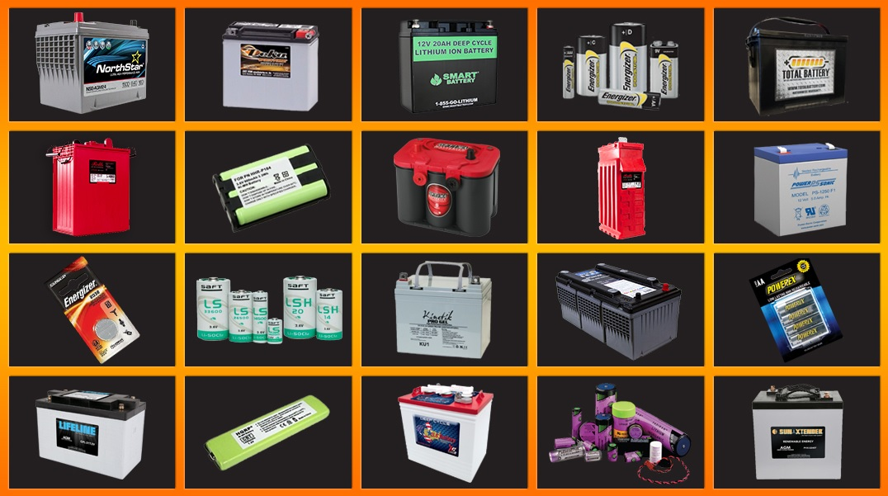
Batteries
Battery Guys- https://batteryguys.com/
Sun Xtender - www.sunxtender.com
Battery Space - www.batteryspace.com
18650 Battery Store – https://www.18650batterystore.com/
DC Battery – www.dcbattery.com
Liion Wholesale - https://liionwholesale.com/

Slide 5
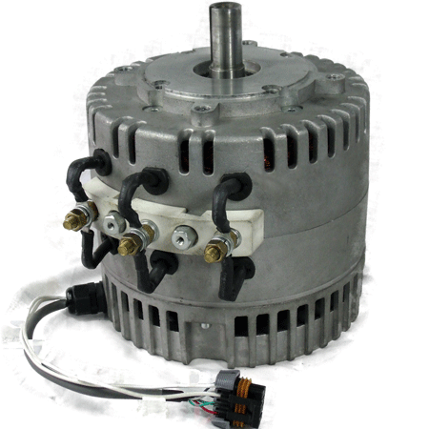
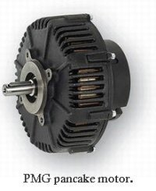
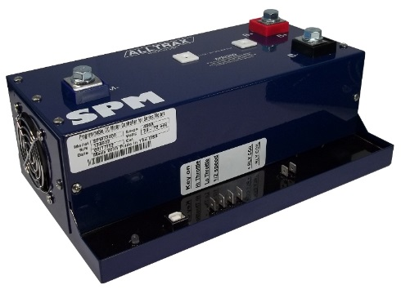
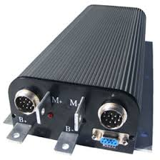
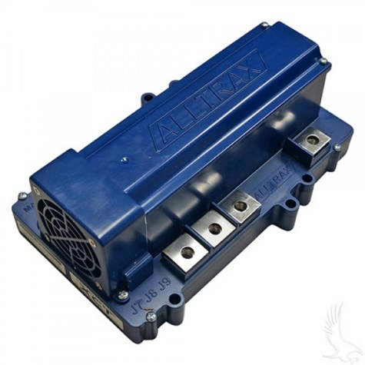
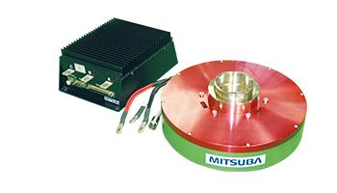
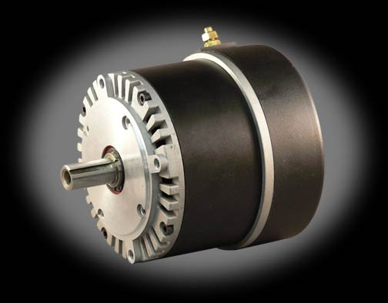
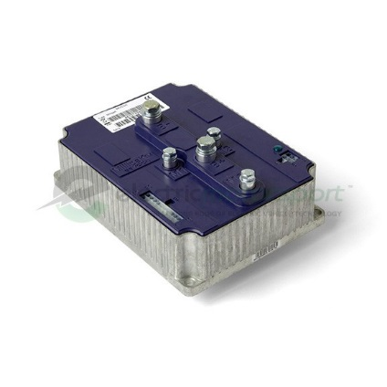
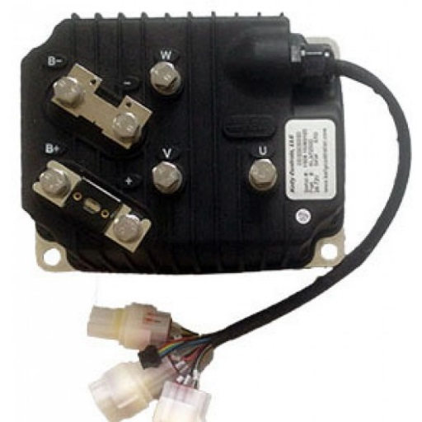
Motors and Controllers
Cloud Electric – http://www.cloudelectric.com
Electric Motorsport - http://www.electricmotorsport.com/
EV Drives – http://www.evdrives.com
Thunderstruck Motors - http://www.thunderstruck-ev.com/
Mitsuba Motors - http://www.mitsuba.co.jp/english/products/solarcarandev
Nomura Co – www.facebook.com/nomuraco

Slide 6
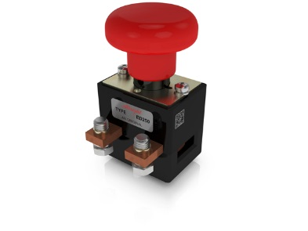
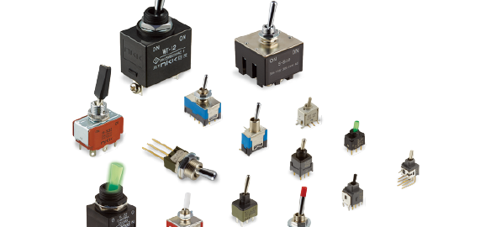
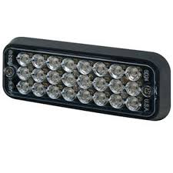
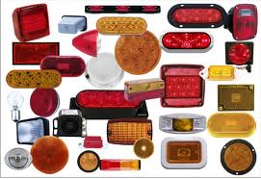
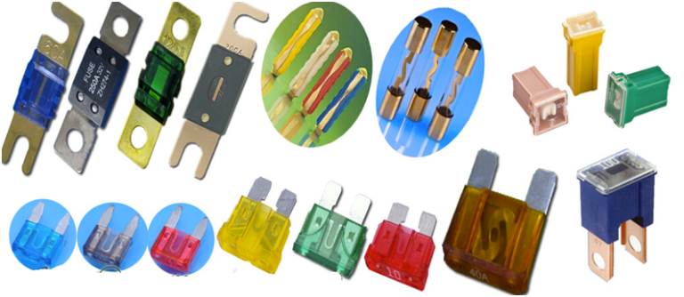
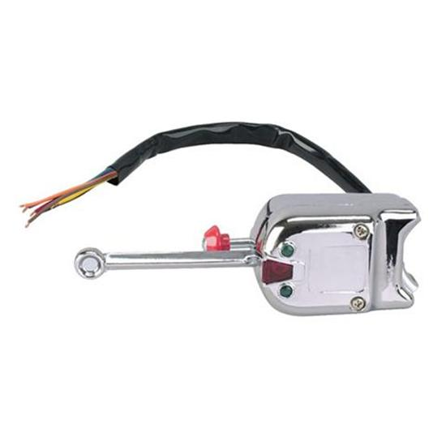
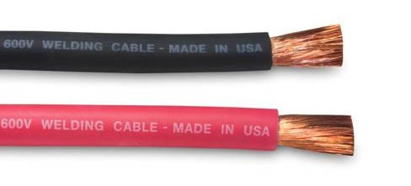
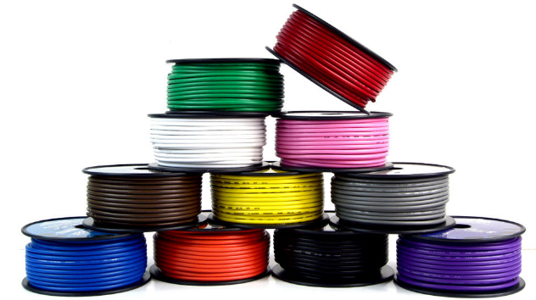
Switches, Disconnects, Lights, Fuses & Wire
SWITCHES / DISCONNECTS
For motor/array disconnects, most teams use Albright International ED250 (up to 48V) or ED250B (up to 96V).
Tecknowledgey - www.tecknowledgey.com
Electric Motorsport – www.electricmotorsport.com
Mouser Electronics – www.mouser.com
DigiKey – www.digikey.com
EV Drives – http://www.evdrives.com
Kimball Midwest - www.kimballmidwest.com
BRAKE LIGHTS & TURN SIGNALS
O’Reilly Auto Parts - www.oreilyautoparts.com
Grainger - www.grainger.com [for ECCO lights]
Etrailer - www.etrailer.com
FUSES
Electric Motorsport – www.electricmotorsport.com
Mouser Electronics – www.mouser.com
DigiKey – www.digikey.com
Grainger – www.grainer.com
Waytek - www.waytekwire.com
McMaster-Carr - www.mcmaster.com
Kimball Midwest - www.kimballmidwest.com
WIRING
Cloud Electric – http://www.cloudelectric.com
Electric Motorsport - http://www.electricmotorsport.com/
EV Drives – http://www.evdrives.com

Slide 7
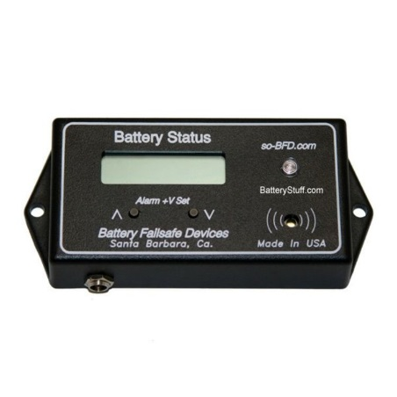
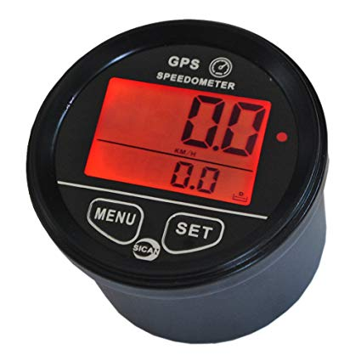
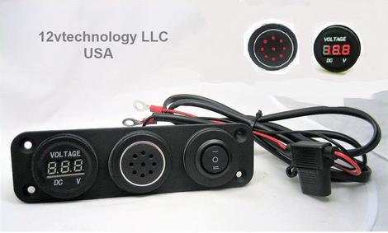
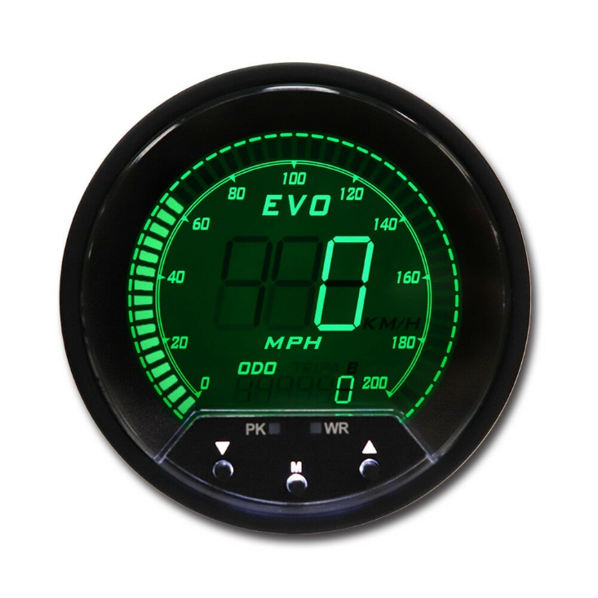
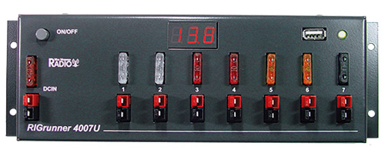

Speedometer, Low Voltage Alarm, Volt/Amp Meter
SPEEDOMETERS
GPS Speedometer – www.speedhut.com
www.ebay.com
LOW VOLTAGE ALARM [12v]
12vtechnology- https://12vtechnology.com/collections/battery-chargers-and-monitors
RIGrunner - http://www.westmountainradio.com/rigrunner.php (fuse block w/ audible alert and 3 LED lights)
Battery Stuff - www.batterystuff.com
Volt & Amp Meters
www.ebay.com

Slide 8
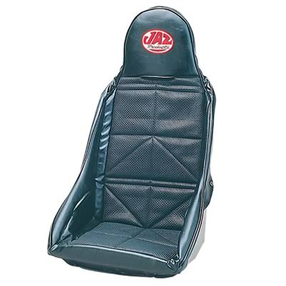
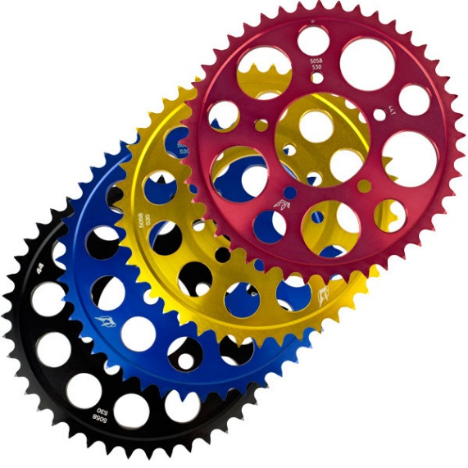
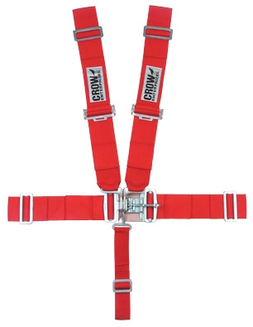
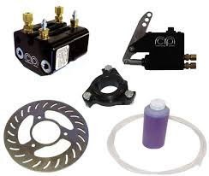
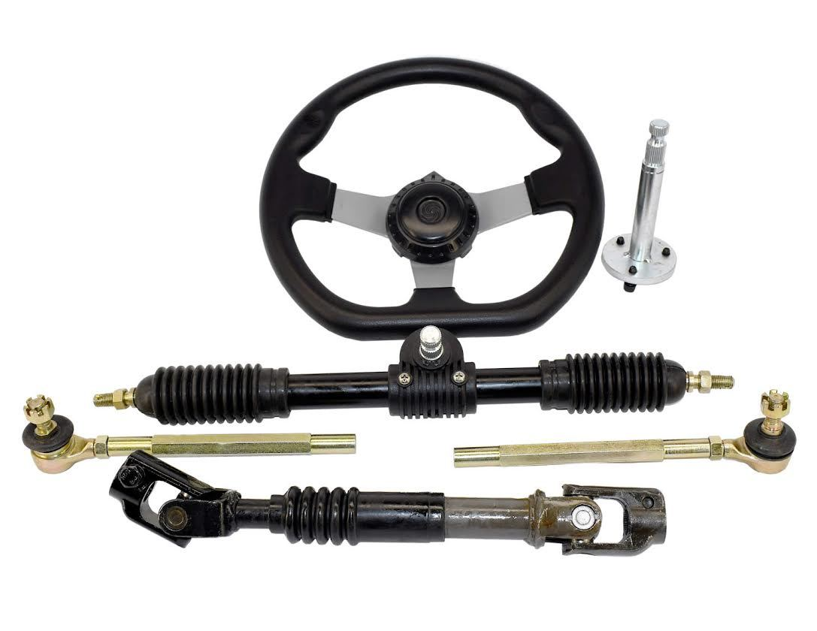
Sprockets, Seats, Seat Belts, Brakes & Steering
CUSTOM SPROCKETS
Rocket Sprockets - www.rocketsprocket.net
Rebel Gears - http://www.rebelgears.com/
Supersprox - http://www.custommotorcyclesprockets.com/
SEATs & Seat BELTS
Summit Racing - www.summitracing.com
Motivational Tubing - www.motivationaltubing.com
Jegs - www.jegs.com
BRAKES
Martin Custom Products - www.mcpbrake.com
Motivational Tubing - www.motivationaltubing.com
Chassis Shop - www.chassisshop.com/
Aliexpress - www.aliexpress.com
STEERING
Motivational Tubing - www.motivationaltubing.com
Chassis Shop – www.chassisshop.com
Go Power Sports - www.gopowersports.com
Aliexpress - www.aliexpress.com

Slide 9
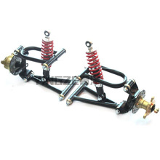
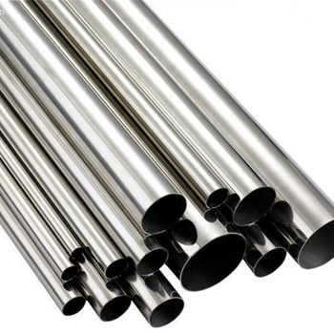
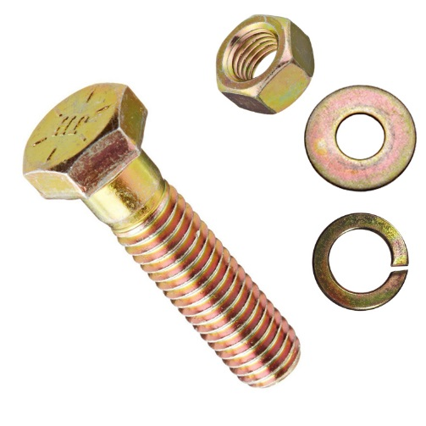
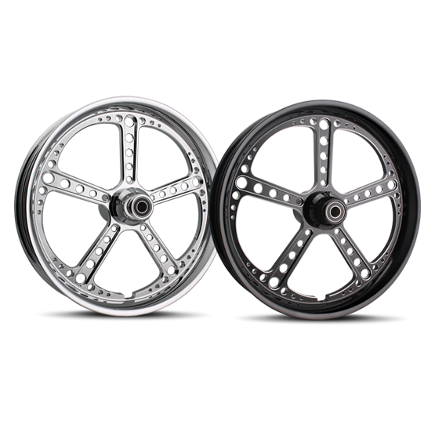
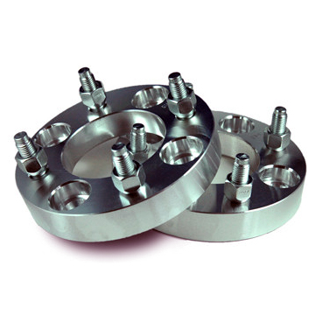
Suspension, Wheels, Metal, Nuts, Bolts, Small Parts
SUSPENSION
ATV A-arm suspension – www.ebay.com
Chassis Shop – www.chassisshop.com
FOX – www.ridefox.com
Aliexpress - www.aliexpress.com
METAL for CONSTRUCTION – [go local if possible]
Online Metals - www.onlinemetals.com
QMF Steel - www.qmfsteel.com
Garland Steel – www.garlandsteel.com
Wicks Aircraft – www.wicksaircraft.com
NUTS/BOLTS/SMALL PARTS
McMaster-Carr - www.mcmaster.com
Kimball Midwest - www.kimballmidwest.com
Bolt Depot – www.boltdepot.com
WHEELS
www.summitracing.com
www.treatland.tv
http://shop.adapterkings.com – they make adapters to go from ATV to Automotive

Slide 10

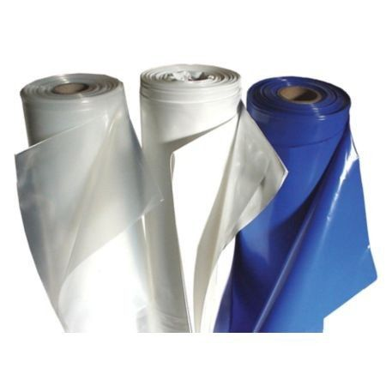
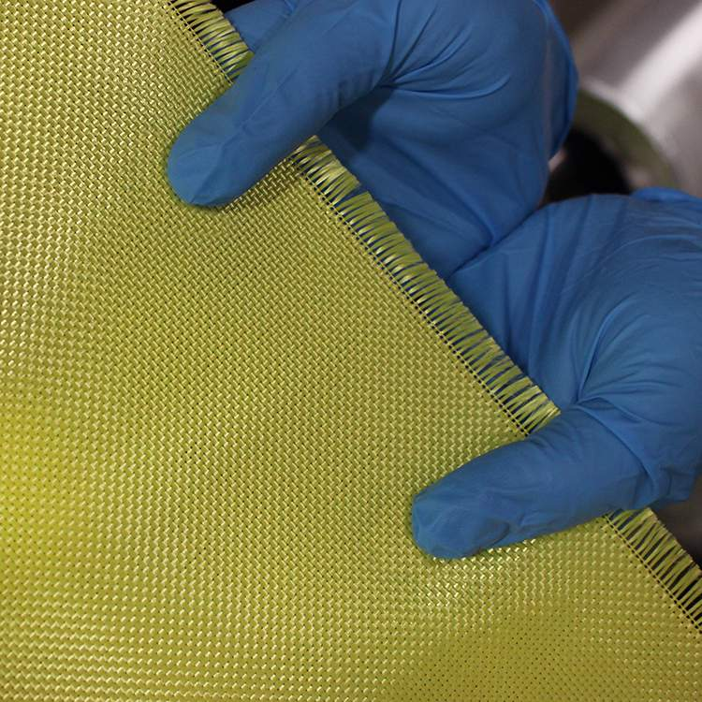
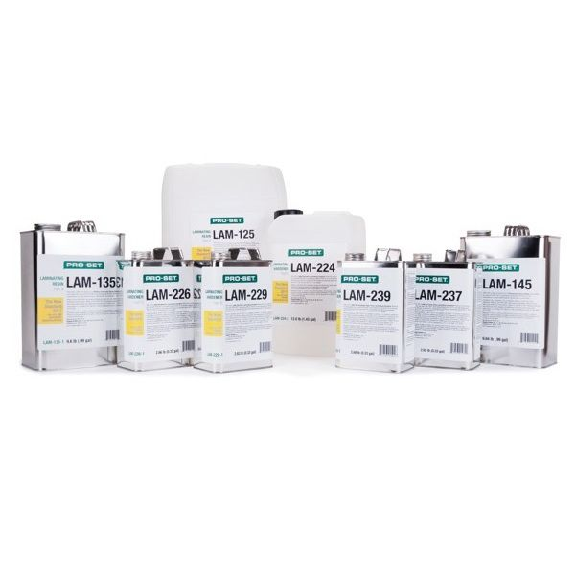
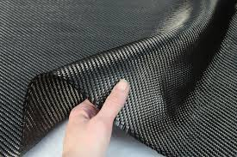

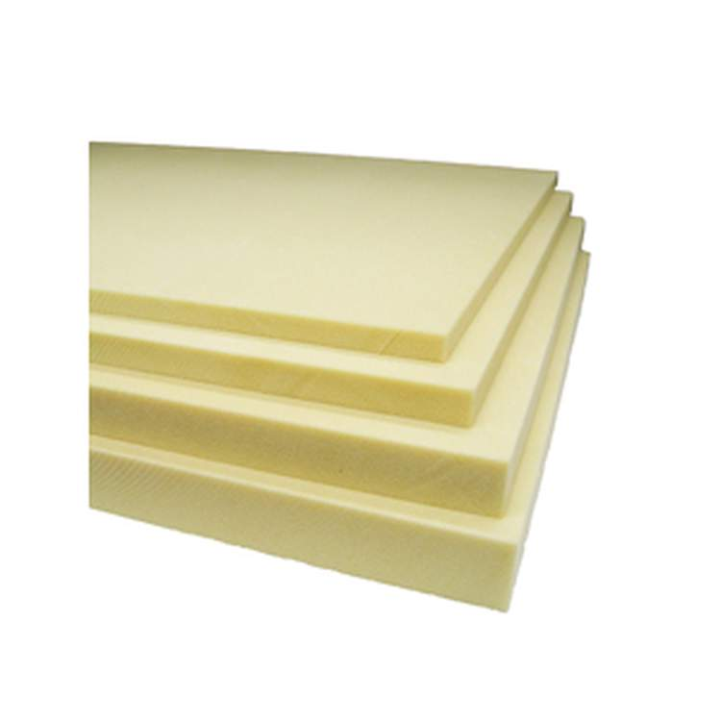
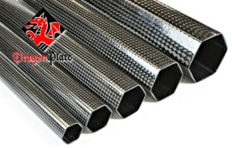
Composite Materials, Shrink Wrap, Foam
COMPOSITE MATERIALS
Express Composites - www.expresscomposites.com
Rock West Composites – www.rockwestcomposites.com
Fibre Glast – www.fibreglast.com
Composite Envisions – www.compositeenvisions.com
Dragon Plate – www.dragonplate.com
SHRINK WRAP
Americover - www.americover.com
Big Shrink - http://www.bigshrink.com
POLYISOCYANURATE FOAM (for Creating Plug)
Foam Mart- www.foammart.com

Slide 11
Custom Fabrication on Demand
Custom Fabrication
Xometry – www.xometry.com
CAD Programs
Solid Edge – https://www.solarcarchallenge.org/challenge/resource.shtml (Free for Solar Car Teams)
onshape – https://www.onshape.com/en/education/ (Free Student & Educator accounts – 100% online)

Slide 12



One Stop Shopping

Slide 13


Ordering From China
Extended Shipping Time
Incomplete Parts
Communication Barrier
No Warranty

Slide 14
Discounts
Ask if they would be willing to sponsor the part or partially sponsor parts
Ask for Free Shipping

Slide 15
Approved Vendors
Build Relationships with Locally owned businesses

Slide 16
Questions?????

